Slide 1
Advanced Algorithms
Weiwei Wu

Slide 2
在信息中，我们的知识去哪儿了？
在知识中，我们的智慧去哪儿了？

Slide 3
Outline
Concepts in algorithm design
  Basic: polynomial time, optimality
    ALG design
    Correctness, time complexity, improvement
  Advanced: Approximation/Competitive
    How much closed is it to OPT
      Experiments on “many” instances
      How to say perform good for “all instances”
This week
  Approximation examples
    Classic example: Knapsack, min makespan
    Research example: related min makespan, min active time

Slide 4
Approximation: concept introduction through classic examples
Optimality？
  Most of the problem have optimality?
  How to get the optimality?
    Math
    Computer, data center, cloud computing
  Powerful？
    No！
    Exp time
  NP-hard
    Hardness for computation
  Bad news
    Most problems are hard
    Big data,
  What to do?

Slide 5
Outline
  Advanced: Approximation/Competitive
    How could u measure the distance
        Difference:|ALG-OPT|<= c
        ALG/OPT<= c,
      In terms of different cases:
        worst case,
        average case
      Different setting:
        offline,
        online,

Slide 6
Outline
Concepts in algorithm design
  Basic: polynomial time, optimality
    ALG design
    Correctness, time complexity, improvement
  Advanced: Approximation/Competitive
    How could u measure the distance
        Difference:|ALG-OPT|<= c
        Ratio: ALG/OPT<= c,
      In terms of different cases:
        worst case,
        average case
      Different setting:
        offline,
        online,
This week
  Approximation examples
    Classic example: Knapsack, min makespan
    Research example: related min makespan, min active time

Slide 7
Approximation: concept introduction through classic examples
Approximation: concept
  Min problem
  Input: an instance
  Output: a solution
  Worst case bound: any instance
    Compare ALG and OPT
    What is the challenging problem here?
      what does the OPT look like?
      ALG(I)/OPT(I)<= c for all I or |ALG(I)-OPT(I)|<= c for all I
    Mission impossible?
    Curiosity?
  Q: use xx to exchange xx?
  Q: max problem?

Slide 8
Approximation: concept introduction through classic examples
Approximation: concept
  Min problem
  Input: an instance
  Output: a solution
  Worst case bound: any instance
      Q: what does the OPT look like?
      ALG(I)/OPT(I)<= c for all I
    how can it be possible?
    Curiosity?
  How could it be possible?
    E.g.1: intermediate UB
      OPT<=x*UB, UB<=y*ALG
    E.g.2: another OPT\ALG We will demonstrate it

Slide 9
Approximation: concept introduction through classic examples
Approximation: example
  Problem: knapsack
    Recall the setting
    Q: what will you do to gain as more as possible?

Slide 10
Approximation: concept introduction through classic examples
Approximation: example
  Problem: knapsack
    Recall the setting
    Q: what will you do to gain as more as possible?
    Q: greedy? In what?
      What if largest value first?
      What if smallest size first? counter examples
      What if proportional first?
    Q: roughly evaluate the solution?
    Q: can it be bad?

Slide 11
Approximation: concept introduction through classic examples
Approximation: example
  Problem: knapsack
    Recall the setting
    Q: what will you do to gain as more as possible?
    Q: greedy? In what? Value, size, or …
    Q: roughly evaluate the solution?
    Q: can it be bad?

Slide 12
Approximation: concept introduction through classic examples
Approximation: example
  Problem: knapsack
    Recall the setting
    Q: what will you do to gain as more as possible?
    Q: roughly evaluate the solution?
    Q: can it be bad?
    Q: how to improve or avoid bad?
    Q: double check?

Slide 13
Approximation: concept introduction through classic examples
Approximation: example
  Problem: knapsack
    Recall the setting
    Q: what will you do to gain as more as possible?
    Q: roughly evaluate the solution?
    Q: can it be bad?
    Q: how to improve or avoid bad?
    Q: double check?
    Q: how far can it be away from the optimal solution?
      Wha t are the properties of the Max strategy
      How far
      Why
    Q: leave open--greedy advanced analysis

Slide 14
Approximation: concept introduction through classic examples
Approximation: example
  Problem: knapsack
v_i: 9 2 4 3 7 8 8 10
c_i: 4 6 4 1 2 8 4 8
OPT=7+9+8
v_i: 3 7 9 8 10 8 4 2
c_i: 1 2 4 4 8 8 4 6
        Rule 1 Proportional: 3+7+9
        Rule 2 value: 10+7

Slide 15
Approximation: concept introduction through classic examples
Approximation: example
  Problem: knapsack
v_i: 9 2 4 3 7 8 8 10
c_i: 4 6 4 1 2 8 4 8
OPT=7+9+8
v_i: 3 7 9 8 10 8 4 2
c_i: 1 2 4 4 8 8 4 6
        Rule 1 Proportional: 3+7+9
        Rule 2’ value: 10
    Q: leave open--greedy advanced analysis

Slide 16
Approximation: concept introduction through classic examples
Approximation: example
  Problem: knapsack
v_i: 9 2 4 3 7 8 8 10
c_i: 4 6 4 1 2 8 4 8
OPT=7+9+8
v_i: 3 7 9 8 10 8 4 2
c_i: 1 2 4 4 8 8 4 6
        Rule 1 Proportional: 3+7+9
        Rule 2’ value: 10
________________ | OPT =7+9+8
__________________ FOPT =3+7+9+8*3/4
_____________|::::::::::: ALG =max 3+7+9, 10
    Q: leave open--greedy advanced analysis

Slide 17
Approximation: concept introduction through classic examples
Approximation: example
  Problem: makespan for identical machine
    m identical machines
    n tasks: each with length l_i
    makespan: maximum completion time
    Goal: min makespan

Slide 18
Approximation: concept introduction through classic examples
Approximation: example
  Problem: makespan for identical machine
    Q: what will you do to gain as more as possible?
    Q: roughly evaluate the solution?
    Q: can it bad?
    Q: how far can it be away from the optimal solution?
      How far
      Why
    Q: leave open—related machine with speed s_j

Slide 19
Approximation: concept introduction through classic examples
Approximation: example
  Problem: makespan for identical machine
  E.g. 3 machines, 7 tasks {2， 4， 1， 5， 3， 1， 3}
Greedy in index： 2 4 1
+3 +5
+1
+3 ALG=8
Greedy in length： 5 4 3
+2 +3
+1
+1 ALG=7
OPT=?
    Q: leave open—related machine with speed s_j

Slide 20
Approximation: concept introduction through classic examples
Analysis:
    A=L_max, B=ALG_min
      where ALG_min denotes the minimum time occupied after ALG allocated
  View M1： ALG<=B+A ➔ ?
  View M2: FOPT suppose that item is divisible
  B’=sum_i l_i/n ➔ B’<=OPT
  ALG<=B’+A ➔ ?
    View M3: FOPT suppose that item is divisible
Visualization
______ ___________
___ ________ _________
_ ________ ___|
B ALG
|
B’=FOPT
    Q: leave open—related machine with speed s_j

Slide 21
Approximation: concept
Competitiveness: concept
  online vs offline
  Input: an instance
  Output: a solution
  Worst case bound: any instance at each time
    Q: what does the OPT look like?
    Approach the future?
      how can it be possible?
    How good can it be?

Slide 22
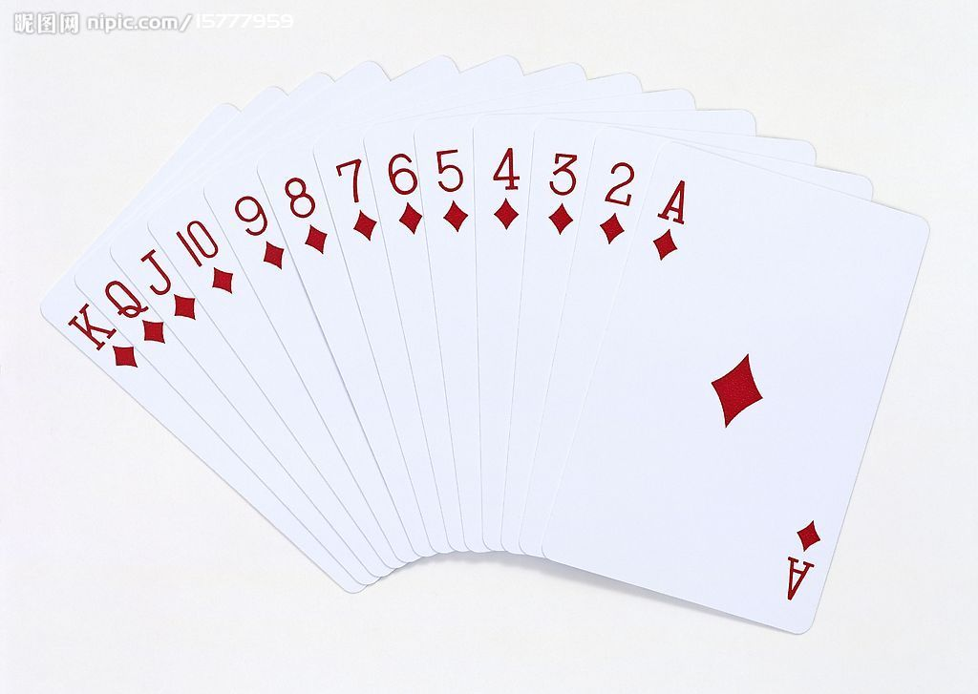
Approximation: concept
Competitiveness: example
  Problem: poker game
    you vs me
    range[1,13]
    I release the poker online
    u draw k times (e.g. n=10,k=3)
    Goal: gain as much as possible
  Alg
  Adversary

Slide 23

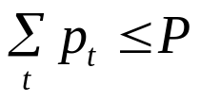
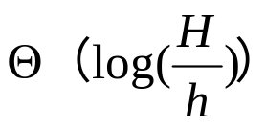



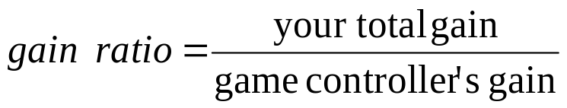
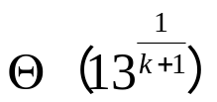
related paper
Network power allocation:
  Online sequence:
  Power budget:
  Time slot t: allocate
  Maximize:
  ALG: R=r^{k+1}; r^1 r^2 r^3 r^k

Slide 24
Approximation/competitive concepts
Problem from research:
online min active time for data center
  1 machine with state active/idle
  n tasks: each task j with
    Processing time p_j
    Release time r_i
    Deadline d_i
  Allocate the tasks with intersection
  Allocate when arrival
  Obj: min total active value
Q: what are the approximation/competitive algorithms
Q: bad example?
  open for you: how to make ‘fast’ offline/online decision

Slide 25
Mobile System, mechanism design and competitiveness
http://cse.seu.edu.cn/people/weiweiwu
weiweiwu@seu.edu.cn
Notes:
Combinatorial Optimization in Action
Flying a plane, riding a bus, buying a writing pad, or making a
phone call: Can you imagine that combinatorial optimization has
something to do with these activities? This lecture will provide
answers and show how the techniques of discrete mathematics
influence our daily life.
Combinatorial optimization in action
Combinatorial optimization exploded on the mathematical and scientific scene in the 1950s. In this lecture I will briefly survey its development for a wide audience. Theoretical design and analysis of algorithms dominated the early development of the field, while computational progress has been particularly significant in the last twenty years. These theoretical and computational achievements, combined with successful modeling of applications, have made it possible today to solve real-world problems of breathtaking size and diversity. The majority of the lecture will report on success stories in areas such as telecommunication, transportation, traffic and logistics. These results are based on ongoing cooperation between industry, the DFG Research Center MATHEON and my research group at Konrad-Zuse-Zentrum (ZIB).

Slide 26
Recap: big O, Ω
T(n)= O(f(n))：
  If there exists c > 0 & integer n_0≥1，such that T(n)≤c*f(n) for any n≥n_0
  e.g. T(n)=3n^3+2n^2，… , ∴T(n)= O(n^3)
Ω
10^9/s，n=60
Complexity： n n^2 n^3 n^5 2^n 3^n
Time: 6*10-8s 3.6*10-6s 2.16*10-4s 0.013min 3.66century 1.3*1013century

Slide 27
Recap: big O, Ω
T(n)= O(f(n))：
  If exists c > 0 & integer n_0≥1，such that T(n)≤c*f(n) for any n≥n_0
  e.g. T(n)=3n3+2n2，… , ∴T(n)= O(n3)
Ω
10^9/s，n=60
complexity n n^2 n^3 n^5 2^n 3^n
Time: 6*10-8s 3.6*10-6s 2.16*10-4s 0.013min 3.66century 1.3*1013century
Insertion sort
Binary sort

Slide 28
Why poly(n) important
E.g. 10^9/s，n=60
complexity n n^2 n^3 n^5 2^n 3^n
Time: 6*10-8s 3.6*10-6s 2.16*10-4s 0.013min 3.66century 1.3*1013century

Slide 29
Possible solving directions
If the problem is poly(n) computable
  Find polynomial time algorithms
  Reduce the time complexity : O(n^2)→O(n^logn)
  Find approximate solution with even faster algorithm
If the problem is difficult
  Prove the problem is NP-hard (mostly)
  Find polynomial time approximation algorithms
    tradeoff the gain with time
  Improve approximation ratio
  Find PTAS → (1+ε) – approximation (weak poly)
  Find FPTAS → (1+ε) – approximation (strong poly)
Prove the hardness of approximation

Slide 30
Network power allocation:
  Online sequence:
  Power budget:
  Time slot t: allocate
  Maximize:
Toy example: Porker game: you vs. game controller
  value range [1-13]
  each time 1 card is released (by game controller)
  n cards will be released one by one (eg. n=10, k=2)
  choose k cards at most
  maximize
Thank you

